Slide 1
Welcome Parents meeting for 2IB
Nesbru vgs, Tuesday 3 September 2024
Ginny Bineypal Hatlemark
Jon Morten Steinveg

Slide 2
Agenda
Support
What is the IB?
CAS
Assessment
University application
How can you support?
Absence policy
2IB parents reps
2IB staff
Useful links
Questions?

Slide 3
Support
Contact teachers – Ginny Bineypal Hatlemark and Jon Morten Steinveg
Counsellor – Ingrid Anita Laulund
Socio-pedagogical
Careers
School nurses – Franziska Sakrisvold and Linn Fanny Broch
-> School psychologist available
IB coordinator – Elizabeth Laney-Mortensen
Extended exams, etc.
Deputy rektor – Hege Sølvberg Nilsen
Study workshop (studieverksted): every day 1430-1600, teachers, food
Social teachers – Mattis Michaelsen and Ina Andem
Library – Donna and Anette: research and study materials

Slide 4
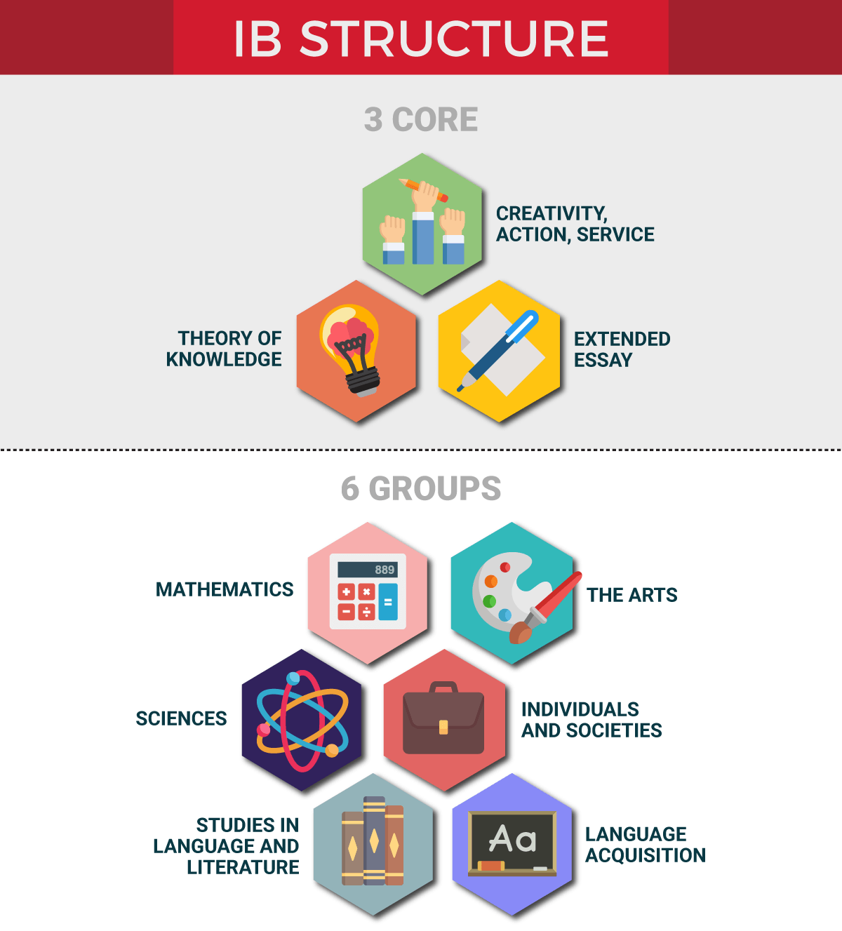
What is the IB Diploma?
Group 1 (A): BEST LANGUAGE
English A literature SL/HL, Norwegian A literature SL/HL, School Supported Self-taught language A SL
Group 2 (B): LANGUAGE ACQUISITION
English B SL/HL, Norwegian B SL/HL, Spanish B SL (online), Mandarin B ab initio (online), a second language from group 1
Group 3: INDIVIDUALS AND SOCIETIES
History SL/HL, Economics SL/HL, Psychology SL
Group 4: SCIENCES
Biology SL/HL, Chemistry SL/HL, Physics SL/HL
Group 5: MATHEMATICS
AA Analysis and approaches SL/HL
AI Applications and interpretation SL/HL
Group 6: THE ARTS / FREE CHOICE GROUP 1-4
Visual arts, free choice from group 1-4

Slide 5
What is the IB Diploma?
Subject and level selection
3 Standard level / 3 Higher level
No extra points for HL
More prestigous subjects? No.
Check minimum university entry requirements
Level of language (A or B)?
Type and level of Maths?
Change level?
SL->HL as soon as; HL->SL end of 3rd term (3IB)
Change subject?
7th October this year

Slide 6
What is the IB Diploma?
The Core: what makes the IB Diploma unique!
Theory of knowledge TOK
Extended essay
Creativity, Action, Service CAS
Holistic education – develop the person
Experiental learning (learning by doing & reflecting)
IB mission statement:
The International Baccalaureate aims to develop inquiring, knowledgeable and caring young people who help to create a better and more peaceful world through intercultural understanding and respect

Slide 7
What is the IB Diploma?
Theory of knowledge TOK
Who produces knowledge, when, where, how, and for what purpose? How do we know the knowledge is reliable? How do we distinguish between knowledge, belief and opinion? How does biases and perspectives influence how we produce knowledge? How does ethics influence how we produce and distribute knowledge?
Develops critical thinking skills, reflection, deeper subject knowledge, connects subjects and real world application
Weekly classes, finishes January last term
Graded: Exhibition and essay

Slide 8
What is the IB Diploma?
Extended essay
4000 word supervised research essay
In one of your subjects
Independent research and writing skills
cirka December 2IB to December 3IB
Graded
TOK and EE grades combined gives 0-3 points for the IB Diploma

Slide 9
What is the IB Diploma?
CAS Creativity, Action, Service
Ginny

Slide 10
CAS – Creativity Activity Service Involving students in enjoyable and significant experiences
CAS Coordinator
Ginny Bineypal Hatlemark

Slide 11
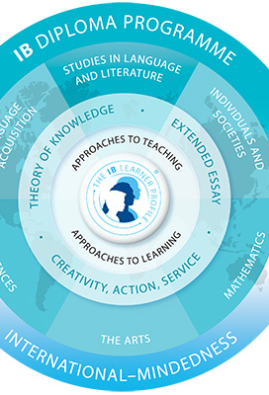
What is CAS?
The three Strands - Creativity Activity and Service
CAS is part of the core, together with TOK and EE
CAS is mandatory
Students need to pass CAS in order to complete the diploma program and get the IB diploma.
CAS is the non- academic part of the IB diploma program.
ManageBac is the digital platform for CAS.

Slide 12
Aim of CAS
To help students develop the characteristics of the Learner Profile
To help students to learn through doing: Experiential Learning

Slide 13
The I.B. Learner Profile and CAS
I.B. participants strive to be
inquirers
knowledgeable
thinkers
communicators
principled
open-minded
caring
risk-takers
balanced
reflective

Slide 14
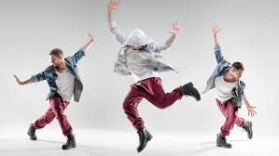
The Nature of CAS: Strand 1
Creativity: exploring and extending ideas leading to an original or interpretive product or performance. This may include visual and performing arts, digital design, writing, film, culinary arts, crafts and composition.

Slide 15
Creative CAS Experiences
Knitting Club
The Book Club → Wednesdays, contact-teacher hour
MUN (also service) → after school
The Coding Club → online
Band → once a week after school
Drama Club?
Painting
Singing
Playing a musical instrument

Slide 16
Strand 2: Activity
Activity: physical exertion contributing to a healthy lifestyle
Pursuits may include individual and team sports, aerobic exercise, dance, outdoor recreation, fitness training, and any other form of physical exertion that purposefully contributes to a healthy lifestyle.

Slide 17
Activity CAS Experiences
Hiking
Jogging
Taekwondo
Training at the gym
Volleyball, football
Skiing/Snowboarding
Activity day
Dance

Slide 18
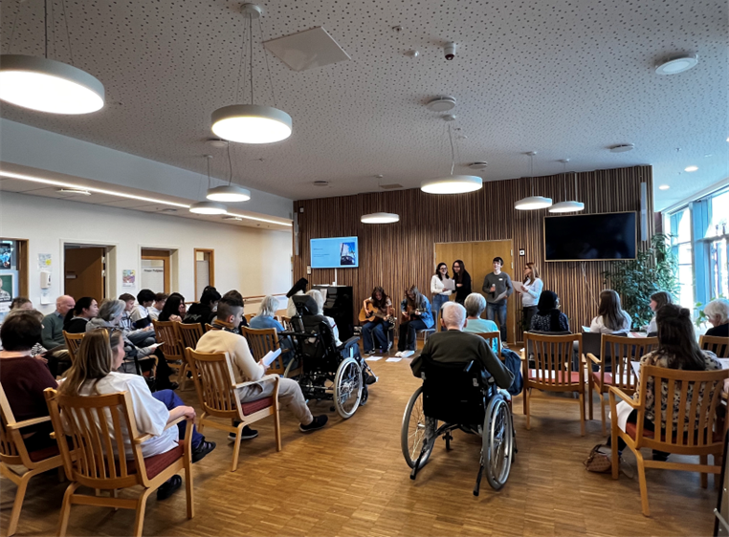
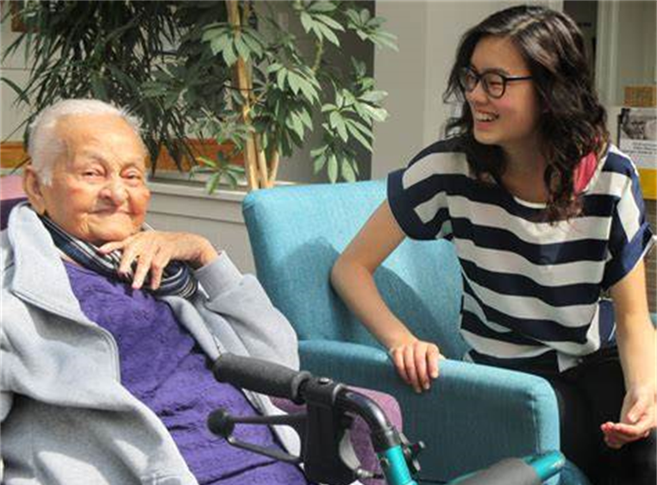
Strand 3: Service
Service: Collaborative and reciprocal enagement with the local and school community in response to authentic need.
School-based service:The Coding Club, Lunch with TO students, helping the librarians, running the IB website and many more …
Community-based service: Nesbru Nursing Home Project (Direct service community project) Visit from the centre in September. Project starts soon after the visit.
Fundraising: Staff lunches to support NNH, Knitting club and Project Less Alone.
Volunteerism: Red Cross, Soup Kitchen, Visiting the elderly at nursing homes
Helping save the environment: Picking plastic and Pacific oysters.

Slide 19
How to CAS
Plan and have experiences that represent Creativity, Activity and Service
Experiences should demonstrate the Learning Outcomes and documented on ManageBac
Experiences
Single experiences
Series of related experiences
CAS projects: collaborative, long-term (minimum 1 month)
Recorded in the CAS Portfolio (Managebac)

Slide 20
CAS Experiences
PLAN → ACT → OBSERVE → REFLECT→RECORD
(Repeat often)

Slide 21
Role of the supervisor
To be familiar with elements of the CAS programme as applicable. Ask the CAS coordinator.
To be responsible for student’s safety and risk management procedures, if applicable.
provide students with guidance, support and feedback on the CAS experience.
encourage students to write reflections.
Encourage students to update CAS portfolio on ManageBac
comment on the student’s engagement with the CAS experience in the completion form.

Slide 22
Assessment
Subject grades:
1 final grade per subject – 3-5 components per subject:
2-3 exam papers May 2026
1-2 supervised essays, oral exams, reports, exhibition, etc. during 2nd year
mostly externally assessed (EA),
some essays, orals, reports, etc internally assessed (IA) and moderated by the IB
No ‘standpunkt’

Slide 23
Assessment
Term grades
set by the teacher in December and June
assessment on tests, classroom tasks, practice essays/reports, end-of-term tests/essays, etc.
indicative of current level
not on the IB Diploma
Predicted grades
the teacher’s best realistic prediction of final grade (realistic – not aspirational)
for university applications in some countries (UK, US) -> conditional offers
during 2nd year (depending on application deadline)
not on the IB Diploma

Slide 24
University
IB Diploma qualifies for university in Norway and worldwide
Study qualification (generell og spesiell studiekompetanse) in Norway
Norwegian A SL / HL and Norwegian B HL
Samordna opptak manages applications for Norway
Conversion table for IB
Same extra points for languages and sciences as other Norwegian students
Nesbru vgs supports university applications abroad
(Limited) information, advice
Teacher references, predicted grades, transcripts, etc
Start research early (but it is OK not to know)
Countries, universities, courses, minimum requirements, finances?
Apply for aspirational/dream, realistic, and safety university courses

Slide 25
Absence and lateness
The expectation is: Ready to start teaching when the lesson starts
O-15 min late – notification (‘anmerkning’)
16 min and more – absence (marked in 45 min intervals)
Send a message to your subject teacher and your student partner
(but this will not save you from getting a notification/absence)

Slide 26
Absence and lateness
10% rule: absence without documentation
Documented absence, up to 10 days a year, includes
Illness, doctor, dentist, hospital + cronic/recurring
Welfare (family)
Political work, volunteering (in some cases), etc.
Participation in sport or culture on national/international level
Some mandatory parts of driving lessons (i.e. Sikkerhetskurs)
The student enter documentation digitally onto VIS
Mine søknader –> Egenmelding –> Opprett egenmelding – whole day absence (heldagsfravær)
Travelling, extended holidays = undocumented absence
Notify your teachers (NB this is not documentation!)

Slide 27
How can you support?
Access to VIS (Visma): timetable, term grades, absence, etc (<18 yrs)
How to access (contact school if you are not in Folkeregisteret or have digital ID):
Visma InSchool - Akershus fylkeskommune (afk.no)
Independent study v. help structure the day/week – calendar
Stressful periods – deadlines – component deadline calendar on Teams
Holidays – school work v. rest

Slide 28
2IB parents reps
1-2 class reps
Establish a parent group communication channel (i.e. Messenger, What’sApp, etc.)
Support the class/school in establishing a sound social and learning environment
Support the class/school in organising social events etc.

Slide 29
2IB staff
Contact details: see school website
Ginny Bineypal Hatlemark – contact teacher, English A, CAS coordinator
Jon Morten Steinveg – contact teacher, Theory of knowledge, Self-taught language A
Elizabeth Laney-Mortensen – IB Diploma coordinator
Hege Sølvberg Nilsen – deputy rektor, IB department manager
… … … …
Ingrid Anita Laulund – counsellor (socio-pedagogical, careers)
Franziska Sakrisvold and Linn Fanny Broch – school nurses
Mattis Michaelsen and Ina Andem – social teachers (contact for parents reps)

Slide 30
2IB staff
English A – Ginny Bineypal Hatlemark
English B – Elizabeth Laney-Mortensen
Norwegian A – Monica Kaasa
Norwegian B – Beate Damsleth
Economics – Banafsheh Sheiban
History – Kari Anne Grøv Revheim
Psychology – Cathrine Reed
Biology – Per-Johan Færøvig
Chemistry – Sofia Ingrid Ommedal
Physics – Anna Dahlsgaard
Mathematics AA (Analysis and approaches) – Fabrice Prieur
Mathematics AI (Applications and interpretation) – Alexander Holen Bjørndal
Visual arts – Elin Drougge

Slide 31
Useful links
Nesbru vgs IB department homepage (student run):
Home | Nesbru High School (ibnesbru.com)
IB Diploma, general information:
https://www.ibo.org/programmes/diploma-programme/curriculum/
IB, subject information:
https://www.ibo.org/university-admission/support-students-transition-to-higher-education/course-selection-guidance/
Samordna opptak, IB for Norwegian universities:
https://www.samordnaopptak.no/info/utenlandsk_utdanning/ib/
Samordna opptak, IB points conversion table (Norway):
https://www.samordnaopptak.no/info/utenlandsk_utdanning/ib/poengberegning/
Samordna opptak, particular entry requirements for Norwegian universities:
https://www.samordnaopptak.no/info/opptak/opptak-uhg/spesielle-opptakskrav/om-spesielle-opptakskrav/

Slide 32
Useful links
ANSA (Association of Norwegian Students Abroad)
ANSA - Association of Norwegian Students Abroad
Study Across the Pond – studier i Storbritannia
Studier i Storbritannia - Across the Pond (studyacrossthepond.com)

Slide 33
?
Thank you!

